Slide 1
Deep Neural Networks
Getting your matrix
dimensions right
Notes:
<number>

Slide 2

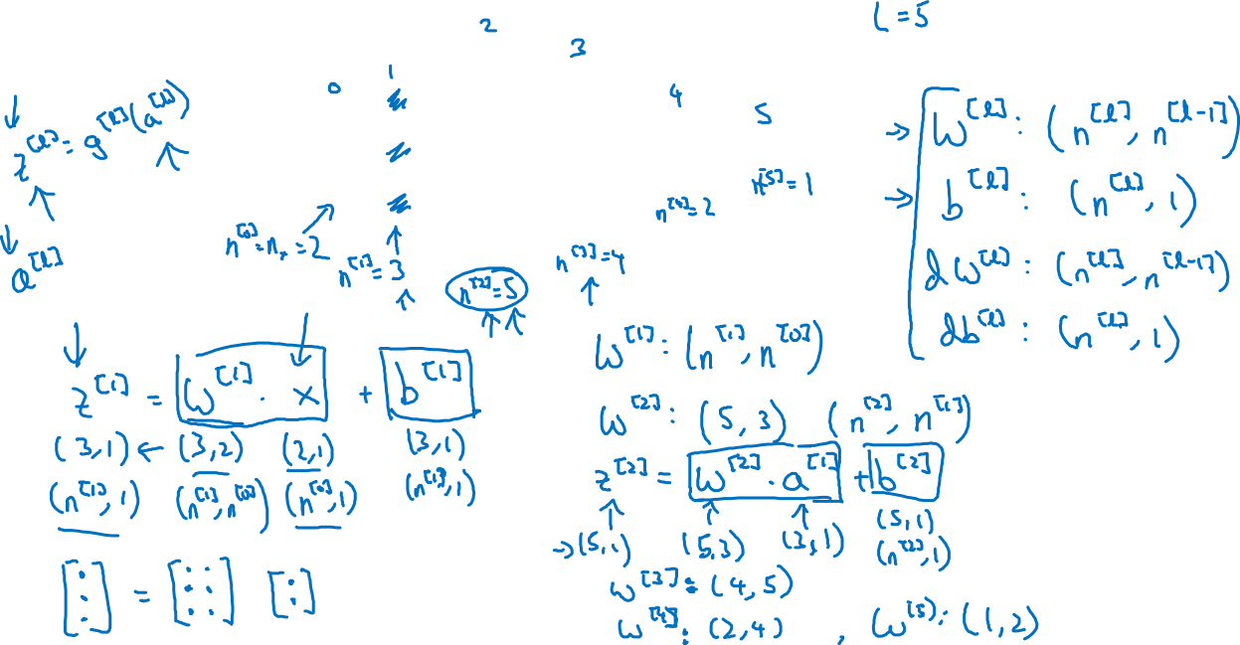




Slide 3
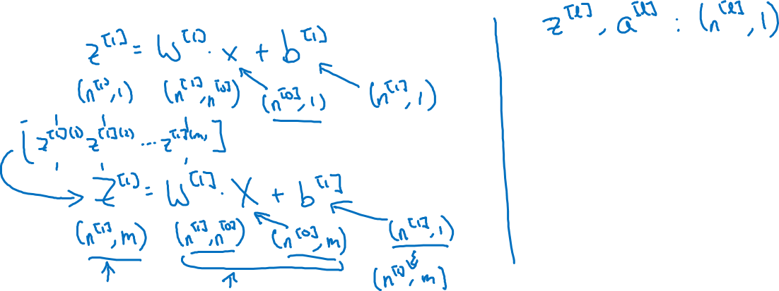
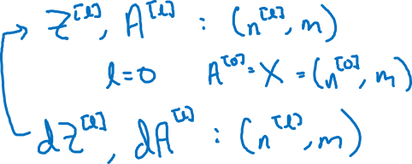
Vectorized implementation

